Slide 2
learn interactive data visualization.
learn applications of business analytics.

Slide 3
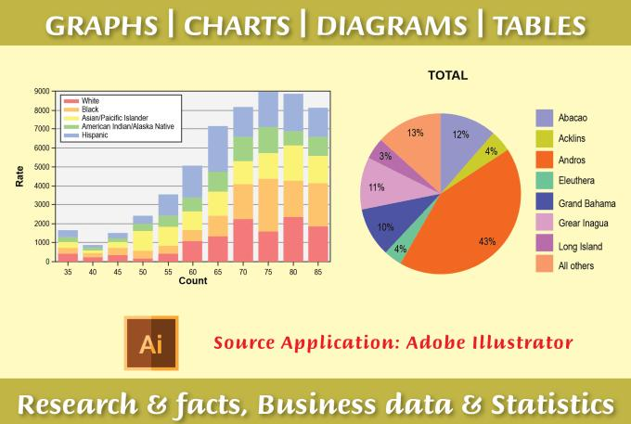
Introduction

Slide 4

Introduction

Slide 5
Interactive Data Visualization

Slide 6
Interactive Data Visualization

Slide 7
Interactive Data Visualization

Slide 8
Interactive Data Visualization

Slide 9
Interactive Data Visualization

Slide 10
Interactive Data Visualization

Slide 11
Interactive Data Visualization

Slide 12
Applications of Predictive Analytics
Customer targeting.
Churn prevention.
Sales forecasting.
Market analysis.
Risk assessment.
Financial modeling.

Slide 13

Customer Targeting

Slide 14
Customer Targeting
Some types of factors used in customer targeting are
Socio-demographic factors
Engagement factors:
Past campaign factors

Slide 15

Churn Prevention

Slide 16
Churn Prevention
Socio-demographic variables
Products contracted
Engagement variables
Some types of attributes used in churn prevention are
Product/service usage
Technical incidents
Stationary variables
Competitor variables

Slide 17

Sales Forecasting

Slide 18
Sales Forecasting
Calendar data
Weather data
Some types of variables used in sales forecasting are
Company data
Social data
Demand data

Slide 19

Quality Improvement

Slide 20
Quality Improvement
Some types of factors used in quality improvement are
Product characteristics
Customer characteristics
Customer surveys

Slide 21

Risk Assessment

Slide 22
Risk Assessment
Socio-demographic factors
Product details
Risk assessment can analyze the following types of data
Customer behavior
Risk metrics

Slide 23

Financial Modeling

